Slide 1
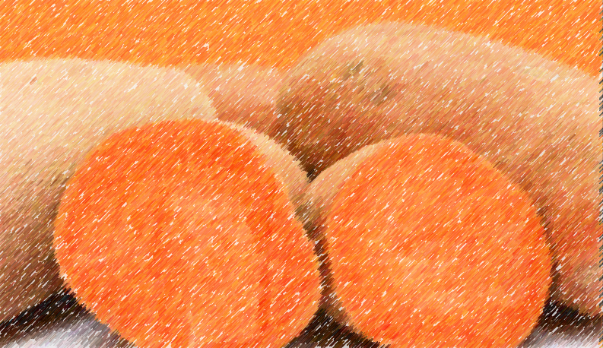
ORANGE-FLESHED SWEET POTATO MARKETABLE YIELD PREDICTION APPLICATION

Slide 2
TEAM MEMBERS
OLAITAN SHARON(PL) - Data collection, inspection and comprehension of data, data cleaning and processing, model tuning and deployment
SAHEED OKIKIOLA – Data collection, contributions to the group
AFOLAYAN PEACE – Data collection, inspection and comprehension of data, model performance evaluation, preparation of slides
OKUNOLA HABEEB – Data collection
RAPHAEL DAVID-ROBERTS – Data collection, contributions to the group

Slide 3
MOTIVATIONS
SOLUTIONS
The search for a cheaper, efficient and more nutritious alternative for flour.
Inability to depict output of sweet potatoes planted.
Collecting data on orange-fleshed sweet potatoes which fit the requirements.
Predict an approximate marketable yield of sweet potatoes planted.
AIM
Our aim is to create a machine learning project that predicts the marketable yield of orange-fleshed sweet potatoes.

Slide 4
BENEFITS OF ORANGE-FLESHED SWEET POTATOES
It is pocket friendly and can be used as an alternative for flour.
It is rich in Vitamin A as it contains beta-carotene.
It helps control diabetes as it functions as insulin to regulate blood sugar levels, hence, it is also edible to diabetic patients.
It has a growth duration of three months from planting to harvest.
Boosts the immune system.
Reduces arthritis pain.
Helps prevent dehydration.
Treatment of inflammation.
Helps improves digestion as it contains fibre.

Slide 5
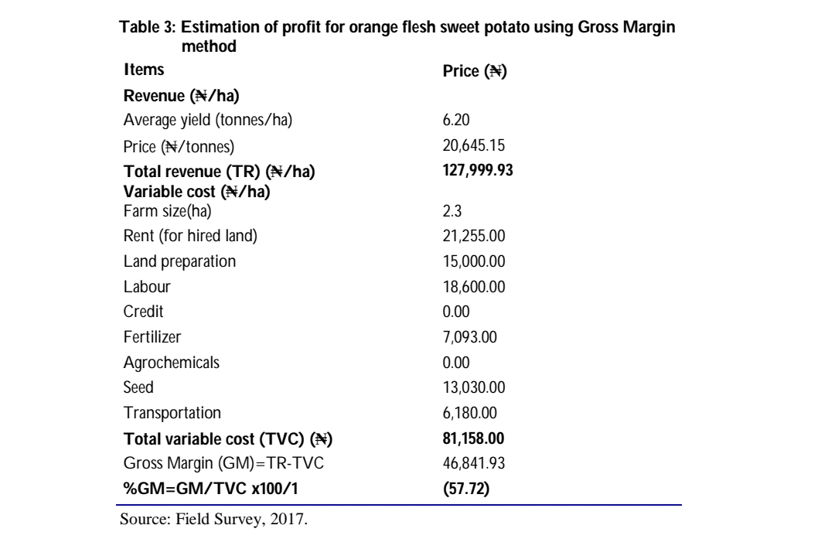
ANALYSIS OF PROFITABILITY OF ORANGE-FLESHED SWEET POTATOES

Slide 6
LIMITATIONS
Being unable to access the orange-fleshed sweet potato dataset in Nigeria, we accessed the dataset from Nkolbisson in Cameroun and Njombe in Tanzania which contains data on both orange-fleshed and white-fleshed sweet potatoes.

Slide 7
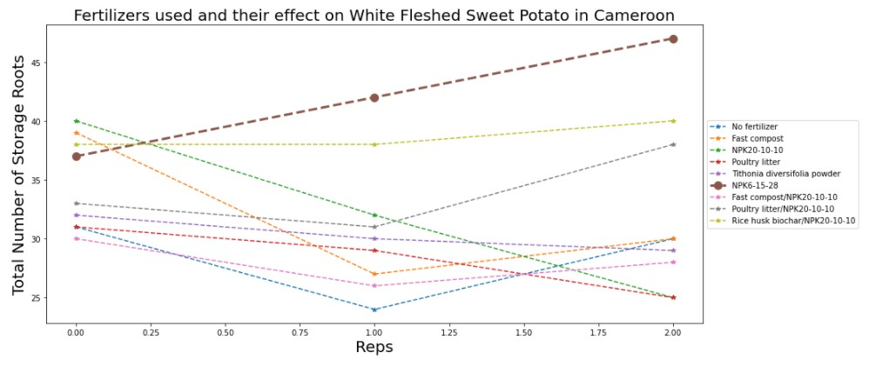
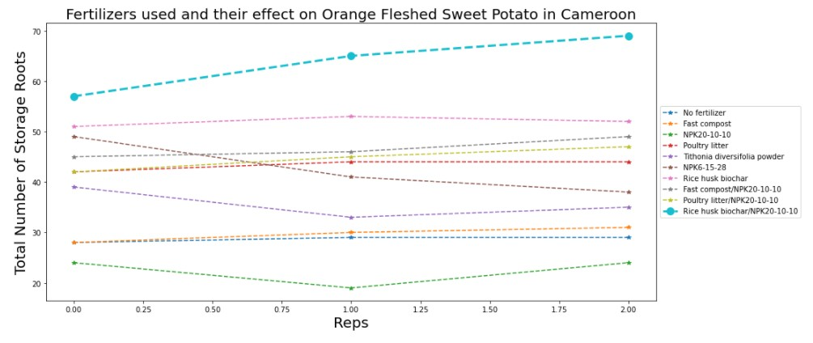
GRAPHICAL REPRESENTATION SHOWING THE DISTINCTION BETWEEN WHITE-FLESHED AND ORANGE-FLESHED SWEET POTATOES
WHITE-FLESHED
ORANGE-FLESHED

Slide 8
WORKFLOW IN DETAILS FEATURES USED FOR ANALYSIS
Location
Type of soil
Fertilizer
Repetitions
Branches
Length of stem
Index of leaf area
Petoile length of leaf
Weight of adventitious root
Weight of the dry biomass
Total storage weight of the roots
Total weight of marketable roots
Total number of roots stored.

Slide 9
TARGET USED FOR ANALYSIS
Marketable Yield

Slide 10
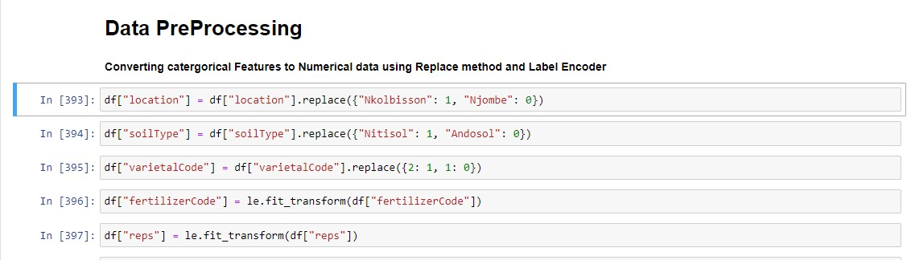
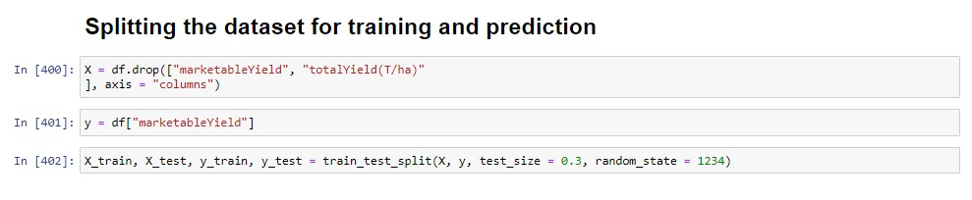
DATA PRE-PROCESSING AND SPLITTING

Slide 11
MODEL EVALUATION
MODEL | Mean Absolute Error | Mean Squared Error
Linear Regressor | 0.003 | 1.111
Gamma Regressor | 1.382 | 4.185
Huber Regressor | 0.053 | 0.004
Passive Aggressive | 0.750 | 0.820
Poisson Regressor | 1.236 | 0.820
Quantile Regressor | 4.088 | 2.576
RANSAC Regressor | 0.003 | 34.47
TheilSen Regressor | 0.003 | 1.092
Tweedie Regressor | 0.576 | 0.446
AdaBoost Regressor | 0.511 | 0.443

Slide 12
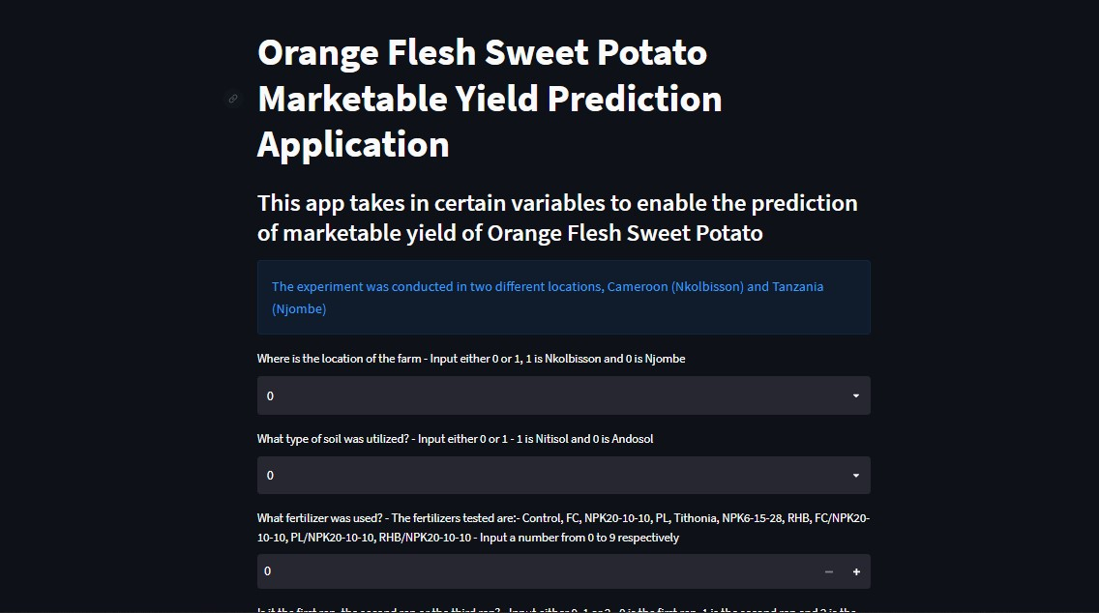
MODEL DEPLOYMENT

Slide 13
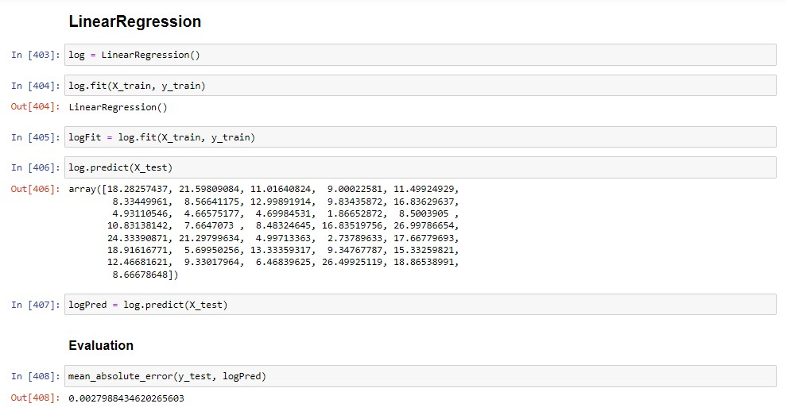
CONCLUSION
After the evaluation of all models, the Linear Regression Model was selected for tuning and deployment:

Slide 14
THANK YOU FOR LISTENING

